Slide 1
K-Means Clustering – Introduction

Slide 2
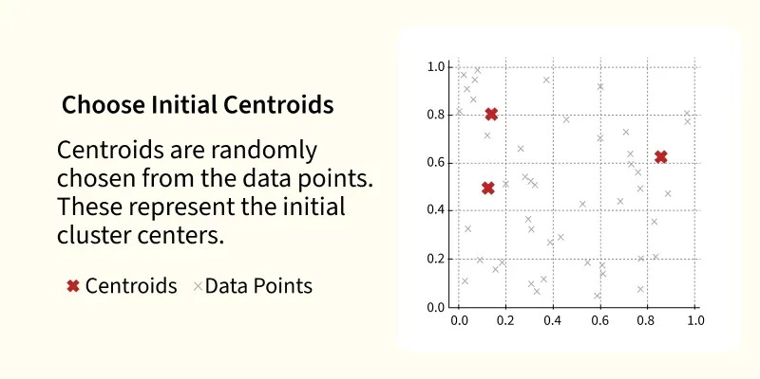
K-Means Clustering is an unsupervised machine learning algorithm that groups similar data points into clusters. It does not need labeled data and creates groups based on the similarity of the data.
Groups similar data points into clusters
Does not require labeled data
Uses the distance between data points and cluster centers
Commonly used for customer segmentation, image compression, and pattern discovery
Working of K-Means Clustering
K-Means divides a dataset into K groups (clusters).
K is the number of clusters you want to create.
The algorithm places similar data points in the same cluster based on their distance from the cluster center (centroid).

Slide 3
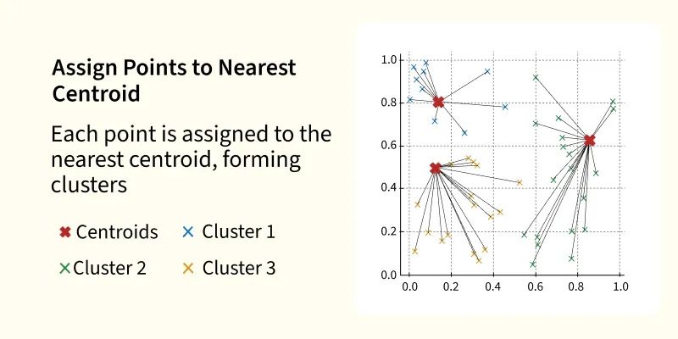
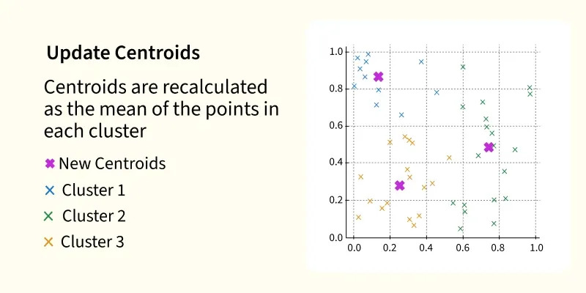

Slide 4
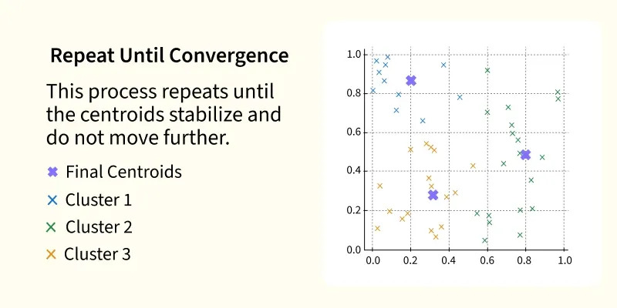
The algorithm divides the data into K clusters based on similarity. It measures similarity using Euclidean distance (distance between data points).
Steps of K-Means:
Initialize – Randomly choose K centroids.
Assign – Assign each data point to the nearest centroid.
Update – Calculate the new centroid by finding the average of all points in each cluster.
Repeat – Repeat the assign and update steps until the centroids stop changing or the maximum number of iterations is reached.
The goal is to group similar data points into the same cluster.

Slide 5
Uses of K-Means Clustering
Customer Segmentation – Groups customers based on similar behavior or buying patterns.
Image Compression – Reduces image size by grouping similar pixels.
Anomaly Detection – Finds unusual or abnormal data points.
Document Clustering – Groups similar documents or articles together.
Data Organization – Organizes large datasets into similar groups for easier analysis.
Implementation of K-Means Clustering
We will use the make_blobs dataset to understand how K-Means creates clusters.
Step 1: Import the Required Libraries
Import the libraries needed for creating the dataset, scaling the data, clustering, and plotting.
import matplotlib.pyplot as plt
from sklearn.datasets import make_blobs
from sklearn.preprocessing import StandardScaler
from sklearn.cluster import KMeans

Slide 6
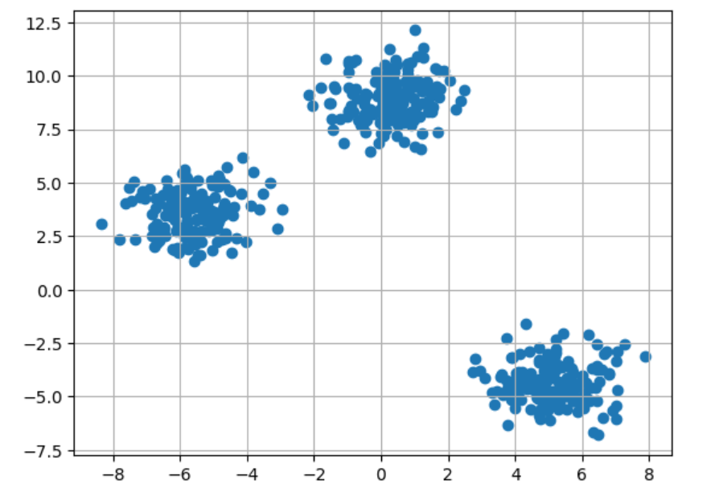
Step 2: Create the Dataset
Create a dataset with 500 data points and 3 clusters.
X, y = make_blobs(n_samples=500, centers=3, random_state=23)
plt.scatter(X[:,0], X[:,1])
(plt.scatter(X[:,0], X[:,1]) creates a scatter plot using the first column of X as the x-axis and the second column as the y-axis.)
plt.grid(True)
plt.show()

Slide 7
Step 3: Scale the Data
Scale the features so that all values are on the same scale.
scaler = StandardScaler()
(Scales all features so they have mean = 0 and standard deviation = 1.)
X = scaler.fit_transform(X)
Step 4: Apply K-Means Clustering
Create a K-Means model with 3 clusters and train it using the dataset.
kmeans = KMeans(n_clusters=3, random_state=23)
kmeans.fit(X)
Step 5: Get Cluster Labels and Centroids
Retrieve the cluster assigned to each data point and the final cluster centers.
labels = kmeans.labels_
centroids = kmeans.cluster_centers_

Slide 8
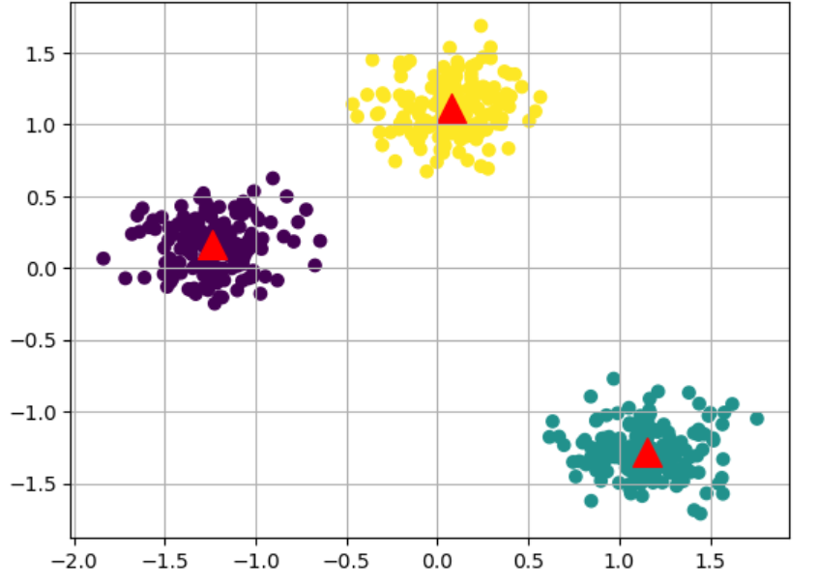
Step 6: Plot the Clusters
Display the clustered data along with the cluster centers.
plt.scatter(X[:,0], X[:,1], c=labels)
(X[:,0] → All rows, first column (x-values) X[:,1] → All rows, second column (y-values)
plt.scatter(centroids[:,0], centroids[:,1],marker='^', c='red', s=200)
(centroids[:,0] → All cluster centers, first column (x-coordinates) centroids[:,1] → All cluster centers, second column (y-coordinates)
plt.grid(True)
plt.show()

